Slide 1
Introduction
Decision trees:
a machine learning method that applies a strategy of dividing data into smaller and smaller portions to identify patterns that can be used for prediction.
Knowledge is presented in the form of logical structures that can be understood without any statistical knowledge.
This aspect makes these models particularly useful for business strategy and process improvement.
They have a high explanatory power.
We can derive rules from the different traversals of the tree.

Slide 2
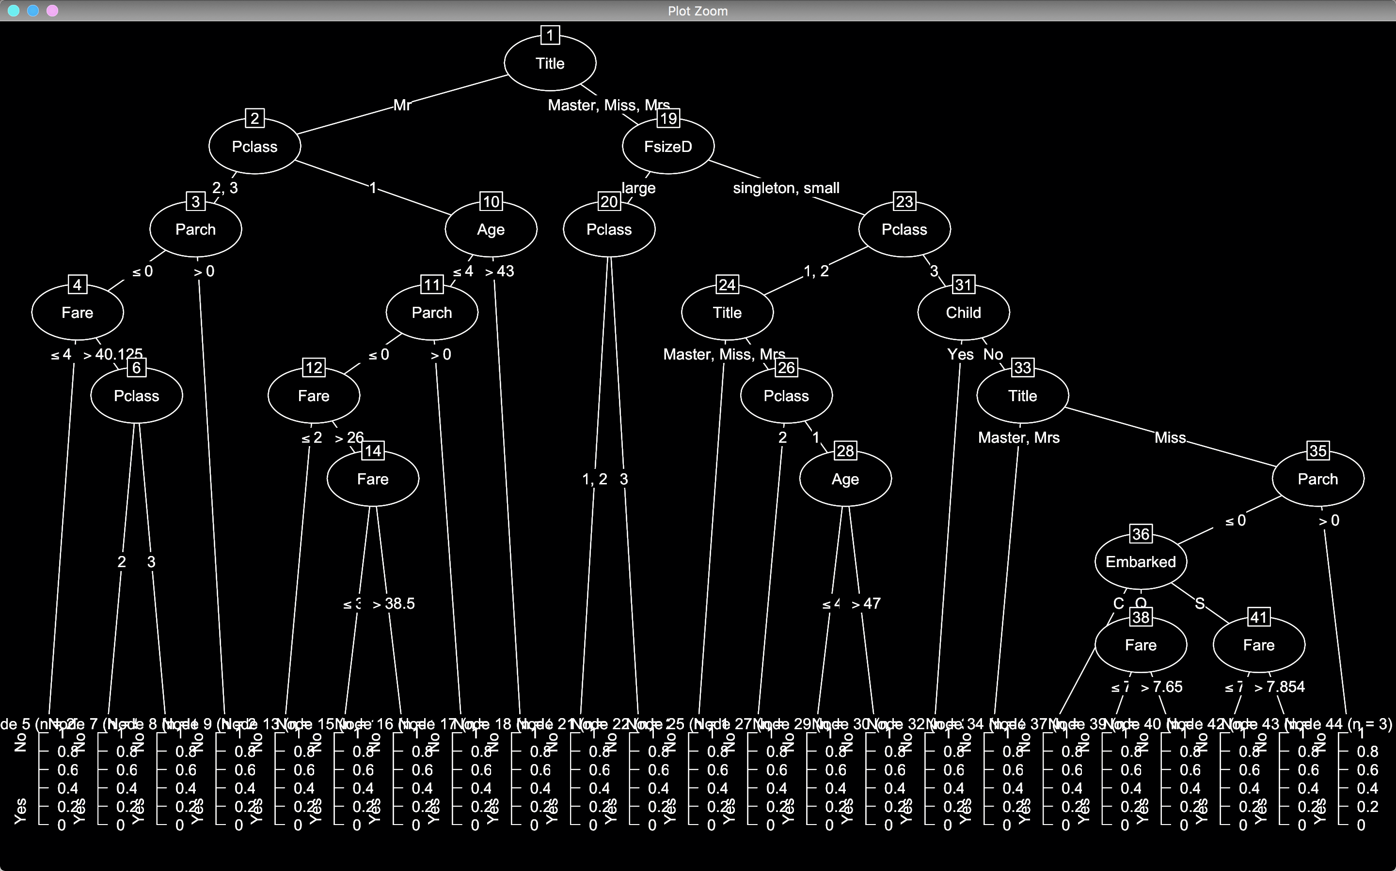
A C50 tree on the Titanic Data set
Root Node, i.e. node 1
Decision node on Pclass. If class is 1 or 2 go left, if 3 go right
Leaf node: provides classification and some statistics: support and confidence

Slide 3
Understanding Decision Trees
Decision tree learners build a model in the form of a tree structure.
The model itself comprises a series of logical decisions, similar to a flowchart
decision nodes then indicate a decision to be made on an attribute.
These split into branches indicating the decision's choices.
The tree is terminated by leaf nodes (also known as terminal nodes) that denote the result of following a combination of decisions.
Data to be classified begins at the root node where it is passed through the various decisions in the tree according to the values of its features.
The path that the data takes funnels each record into a leaf node, which assigns it a predicted class.
As the decision tree is essentially a flowchart, it is particularly appropriate for applications in which the classification mechanism needs to be transparent for legal reasons or the results need to be shared in order to facilitate decision making.

Slide 4
Uses of Decision Trees
Decision trees have wide uses.
Credit scoring models the criteria that causes an applicant to be rejected need to be well-specified
Marketing studies of customer churn or customer satisfaction that will be shared with management or advertising agencies
Diagnosis of medical conditions based on laboratory measurements, symptoms, or rate of disease progression.
They can be applied to both classification and regression problems
In practice decision trees are perhaps the single most widely used machine learning technique.
They can be applied for modeling almost any type of data—often with unparalleled performance.

Slide 5
Divide & Conquer
Decision trees are built using a heuristic called recursive partitioning.
This approach is generally known as divide and conquer because it uses the feature values to split the data into smaller and smaller subsets of similar classes.
Beginning at the root node, which represents the entire dataset, the algorithm chooses a feature that is the most predictive of the target class.
The examples are then partitioned into groups of distinct values of this feature; this decision forms the first set of tree branches.
The algorithm continues to divide-and-conquer the nodes, choosing the best candidate feature each time until a stopping criterion is reached.
This might occur at a node if:
All (or nearly all) of the examples at the node have the same class
There are no remaining features to distinguish among examples
The tree has grown to a predefined size limit.

Slide 6
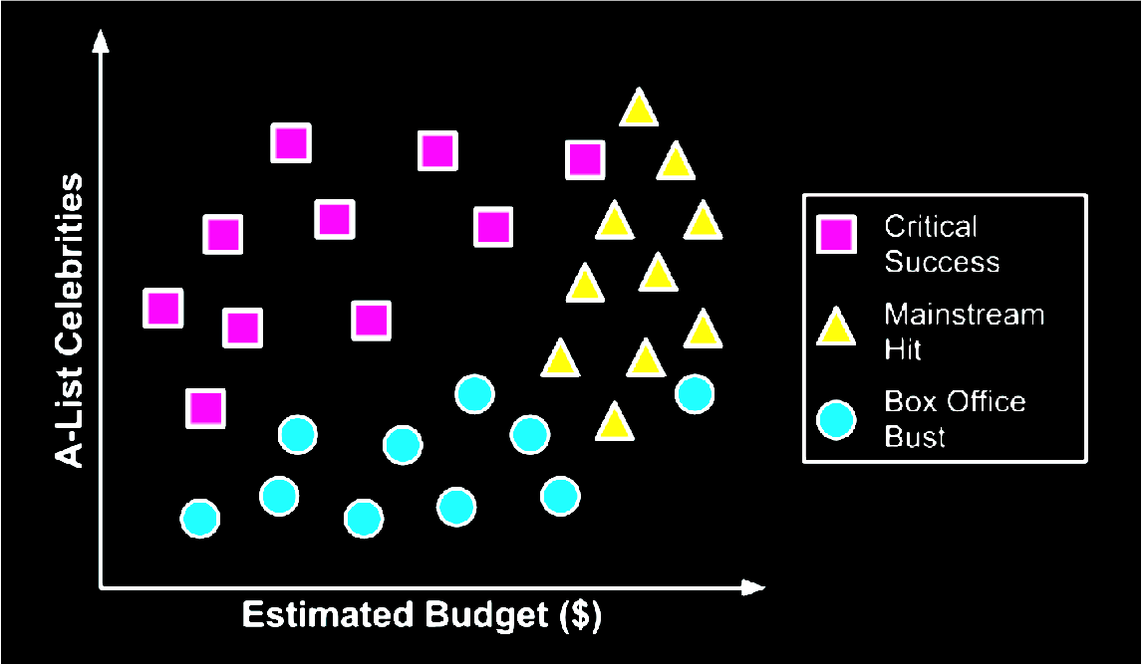
Divide & Conquer
You decide to develop a decision tree algorithm to predict whether a potential movie would fall into one of three categories: mainstream hit, critic's choice, or box office bust

Slide 7
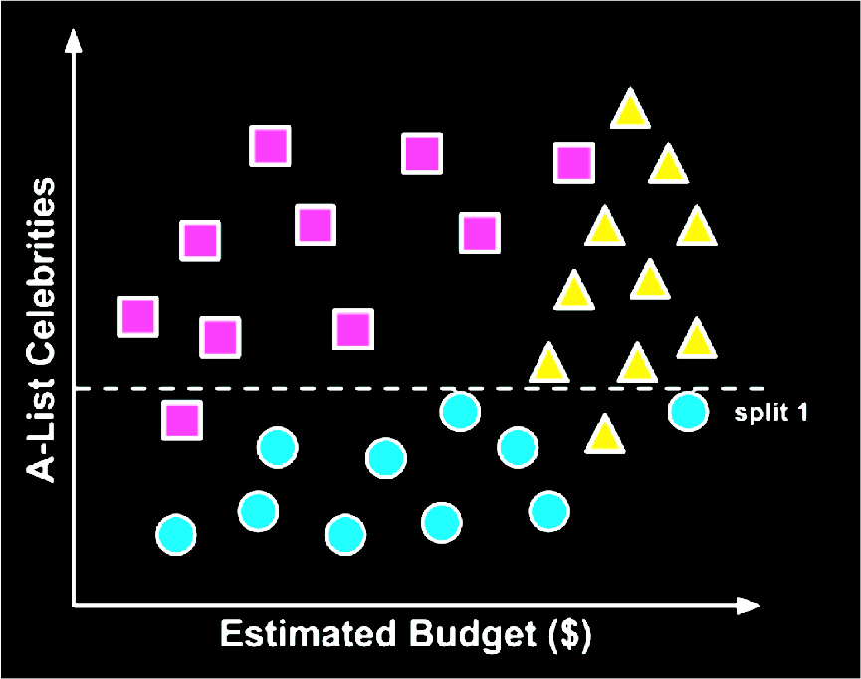
Divide & Conquer
To build a simple decision tree using this data, we can apply a divide-and-conquer strategy.
Let's first split the feature indicating the number of celebrities, partitioning the movies into groups with and without a low number of A-list stars:
Split into low number of A-list stars and high number of A-list starts.

Slide 8
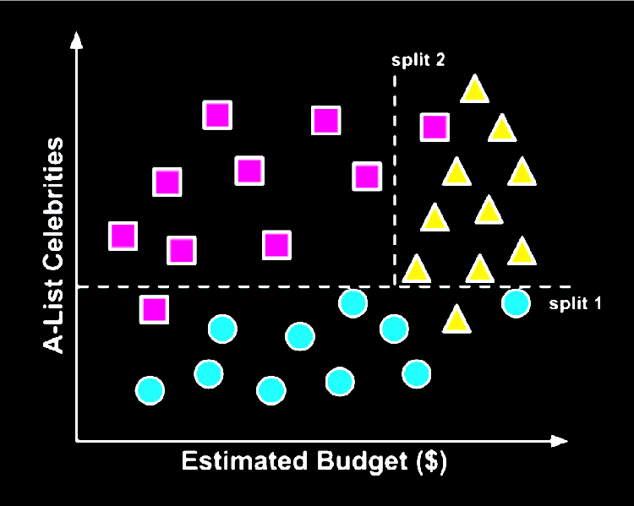
Divide & Conquer
Next, among the group of movies with a larger number of celebrities, we can make another split between movies with and without a high budget:
At this point we have partitioned the data into three groups.
The group at the top-left corner of the diagram is composed entirely of critically-acclaimed films. This group is distinguished by a high number of celebrities and a relatively low budget.
At the top-right corner, the majority of movies are box office hits, with high budgets and a large number of celebrities.
The final group, which has little star power but budgets ranging from small to large, contains the flops.

Slide 9
Divide & Conquer
If we wanted, we could continue to divide the data by splitting it based on increasingly specific ranges of budget and celebrity counts until each of the incorrectly classified values resides in its own, perhaps tiny partition.
Since the data can continue to be split until there are no distinguishing features within a partition, a decision tree can be prone to be overfitting for the training data with overly-specific decisions.
We'll avoid this by stopping the algorithm here since more than 80 percent of the examples in each group are from a single class.

Slide 10
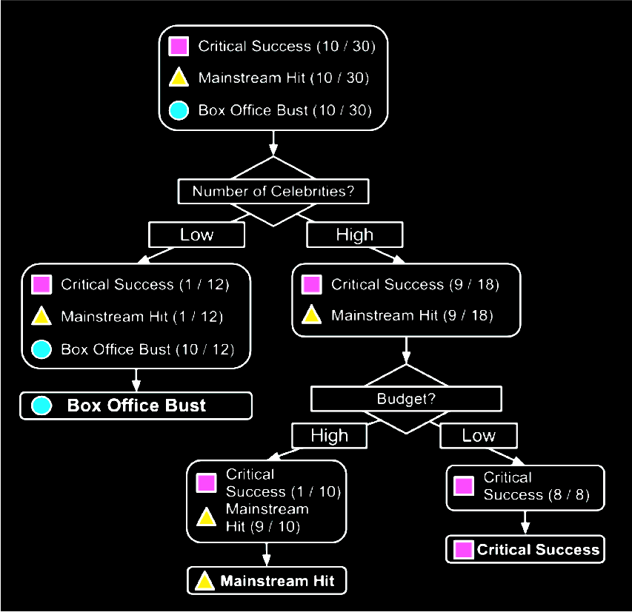
Divide & Conquer
Our model for predicting the future success of movies can be represented in a simple tree as shown.
To evaluate a script, follow the branches through each decision until its success or failure has been predicted.
Decision Nodes
Leaf Nodes

Slide 11
Divide & Conquer
Support & Confidence
Consider the following decision tree for providing a loan to a person.
The training set contains 15 examples.
The x/y values mean that x out of y training examples that reach this leaf node have the class of the leaf.
The x/y value is considered the confidence value
The x value is the support count. The support at a leaf node will be x/(total number of training examples)
Own house?
YES
Has job?
6/6
YES
NO
3/3
6/6

Slide 12
Divide & Conquer
Note:
There may be many decision trees that can be learned from the data, and most decision tree algorithms have stochastic properties: so BUILD LOTS!!
In practice, we would like small, accurate trees
A smaller tree tends to be more general and also more accurate
Easier to understand by human users – Important in many cases
Smaller trees also generalize the data better, and are thus less susceptible to overfitting.
For most real-world datasets, the training examples that reach leaf nodes will not all have the same class.
A decision tree only finds a subset of the rules that exist in the data which is sufficient for classification.

Slide 13
Algorithms – C5.0
There are numerous implementations of decision trees, but one of the most well known is the C5.0 algorithm.
This algorithm was developed by computer scientist J. Ross Quinlan as an improved version of his prior algorithm, C4.5, which itself is an improvement over his ID3 (Iterative Dichotomiser 3) algorithm.
The C5.0 algorithm has become the industry standard for producing decision trees, because it does well for most types of problems directly out of the box.
Compared to other advanced machine learning models (such as Black Box Methods – Neural Networks and Support Vector Machines) the decision trees built by C5.0 generally perform nearly as well but are much easier to understand and deploy.

Slide 14
C5.0 Algorithm – Where to split
The first challenge that a decision tree will face is to identify which feature to split upon. In the movie example, we looked for feature values that split the data in such a way that partitions contained examples primarily of a single class.
If the segments of data contain only a single class, they are considered pure.
There are many different measurements of purity for identifying splitting criteria.
C5.0 uses entropy for measuring purity.
The entropy of a sample of data indicates how mixed the class values are; the minimum value of 0 indicates that the sample is completely homogenous, while 1 indicates the maximum amount of disorder.
Other commonly used criteria are Gini index, Chi-Squared statistic, and gain ratio.

Slide 15
Algorithms – Pruning
A decision tree can continue to grow indefinitely, choosing splitting features and dividing into smaller and smaller partitions until each example is perfectly classified or the algorithm runs out of features to split on.
However, if the tree grows overly large, many of the decisions it makes will be overly specific and the model will have been overfitted to the training data.
The process of pruning a decision tree involves reducing its size such that it generalizes better to unseen data.
Two basic approaches:
Pre-pruning
Post-pruning

Slide 16
Algorithms – Pre-pruning
One solution to this problem is to stop the tree from growing once it reaches a certain number of decisions or if the decision nodes contain only a small number of examples.
This is called early stopping or pre-pruning the decision tree.
As the tree avoids doing needless work, this is an appealing strategy.
However, one downside is that there is no way to know whether the tree will miss subtle, but important patterns that it would have learned had it grown to a larger size.

Slide 17
Algorithms – Post-pruning
An alternative, called post-pruning involves growing a tree that is too large, then using pruning criteria based on the error rates at the nodes to reduce the size of the tree to a more appropriate level.
This is often a more effective approach than pre-pruning because it is quite difficult to determine the optimal depth of a decision tree without growing it first.
Pruning the tree later on allows the algorithm to be certain that all important data structures were discovered.
One of the benefits of the C5.0 algorithm is that it is opinionated about pruning—it takes care of many of the decisions, automatically using fairly reasonable defaults.
Its overall strategy is to postprune the tree.

Slide 18
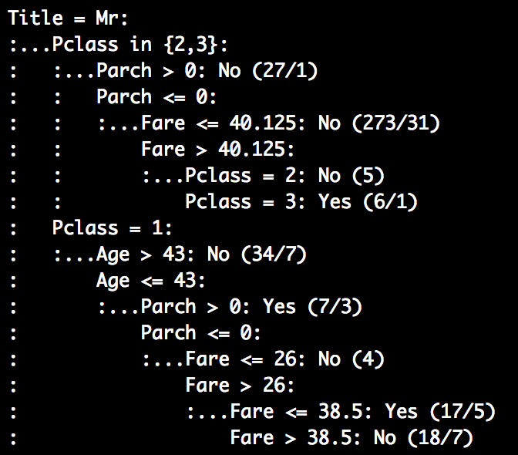
Sample output: titanic in this case
This is only part of one path from root to leaf.
The first lines could be represented in plain language as:
If the title of the passenger is Mr
If Pclass is 2 or 3, AND
If Parch > 0: predict did not survive. 27 training instances reach this node, and 1 would be incorrectly classified, i.e. they survived
If instead Parch <= 0 (0 in this case, cannot be less than 0) AND
Fare <= 40.125: predict did not survive. 273 training instances reach this node, and 31 would be incorrectly classified
…

Slide 19
Boosting the accuracy of decision trees
Train many decision trees who vote on the best class for each example.
Boosting: combining a number of weak models creates a group that is holistically strong. Each models has a unique set of strengths and weaknesses, and may be better or worse at certain problems.
Using a combination of several learners with complementary strengths and weaknesses can therefore dramatically improve the accuracy of a classifier.
The C5.0() function makes it easy to add boosting to our C5.0 decision tree: the trials parameter.
trials = n corresponds to: build n C5.0 trees.
Boosting can dramatically reduce the error compared to a single C5.0 tree.
The idea of boosting is the basic premise of ensembles: where we combine multiple classifiers into a base layer, and use another model to decide how to interpret their views (predictions) to produce the final prediction.

Slide 20
Extracting Rules
The last thing (for now) that we may wish to do with a C5.0 (as well as any decision tree) is transform the tree model into a series of rules.
For this we simply use the rules parameter; rules = TRUE.

Slide 21
C5.0 Strengths and Weaknesses
Strengths | Weaknesses
An all-purpose classifier that does well on most problems | Decision tree models are often biased toward splits on features having a large number of levels
Highly-automatic learning process can handle numeric or nominal features, missing data | It is easy to overfit or underfit the model
Uses only the most important features | Can have trouble modeling some relationships due to reliance on axis parallel splits
Can be used on data with relatively few training examples or a very large number | Small changes in training data can result in large changes to decision logic
Results in a model that can be interpreted without a mathematical background (for relatively small trees) | Large trees can be difficult to interpret and the decisions they make may seem counterintuitive
More efficient than other complex models

